Slide 1
Bayesian II Intermediate Bayesian Analyses with JAGS for Fish and Wildlife Professionals
2019 AFS/TWS Joint National Meeting
Reno, NV
September 29, 2019
Instructors: Ben Staton¹ and Henry Hershey²
¹Columbia River Inter-Tribal Fish Commission; Fisheries Science Department
²Auburn University; School of Fisheries, Aquaculture, and Aquatic Sciences

Slide 2
Outline For Today
Morning: Intro and Fitting Models
Review of generalized linear models
Logistic regression
Poisson regression
Model checking with posterior predictive checks
Afternoon: More Complex Models
Zero-inflated Poisson regression
Review of mixed-effects/hierarchical models
Mixed-effect logistic regression
State-space Cormack-Jolly-Seber model with variations

Slide 3
Outline For Today
Morning: Intro and Fitting Models
Review of generalized linear models
Logistic regression
Poisson regression
Model checking with posterior predictive checks
Afternoon: More Complex Models
Zero-inflated Poisson regression
Review of mixed-effects/hierarchical models
Mixed-effect logistic regression
State-space Cormack-Jolly-Seber model with variations

Slide 4
Review of Regression
Yesterday, we covered linear regression:
y_{i} = B₀ + B₁ * x_{1,i} + ε_{i}
ε_{i} ~ N(0,σ)
Assumes error around line is normally distributed with mean of zero
Many analyses do not meet this assumption
or others, e.g., continuous y-variable

Slide 5
Generalized Linear Models (GLMs)
Simple linear regression is a member of a broader class of statistical models termed collectively “Generalized Linear Models”
Can handle other data types
Binary: success/failure (e.g., lived/died, seen/not seen, etc.)
Counts: e.g., catch/day, redds/km, etc.
Example questions:
How does probability of survival differ at various densities?
How does the frequency of tick bites differ by season, year, or geographic area?

Slide 6
Three parts to GLMs
1.) Linear predictor – the deterministic part
2.) Link function – links the linear predictor to the response
3.) Statistical response distribution – the stochastic part

Slide 7
Three parts to GLMs
1.) Linear predictor – the deterministic part
2.) Link function – links the linear predictor to the response
3.) Statistical response distribution – the stochastic part

Slide 8
The Linear Predictor
A linear combination of effects and predictor variables that specifies how a function of the expected response changes
g(E(x)) = B₀ + B₁ * x₁
E(x) is the expected response at x₁ = x
g() is the link function
Linear predictor is not on the same scale as the data

Slide 9
Three parts to GLMs
1.) Linear predictor – the deterministic part
2.) Link function – links the linear predictor to the response
3.) Statistical response distribution – the stochastic part

Slide 10
The Link Function
Linear predictors can go from –∞ to ∞
Not all responses follow this
Link allows use of linear model to predict a response that (for example):
Must be > 0
Must be (0,1)

Slide 11
Common Link Functions
η is the linear predictor: B₀ + B₁*x₁
Logit link
Constrains expected response to be between 0 and 1
Transform to logit scale: η = log(p/(1- p)): log odds
Bring back to probability scale: p = exp(η)/(1+exp(η))
Log link
Constrains expected response to be positive
Transform to log scale: η = log(x)
Bring back to natural scale: exp(η)
Identity link
The expected response is the same as the linear predictor
Simple linear regression uses the identity link
E(x) = η

Slide 12
Fear Not
If this is nonsense,
JAGS takes care of much of it!

Slide 13
Three parts to GLMs
1.) Linear predictor – the deterministic part
2.) Link function – links the linear predictor to the response
3.) Statistical response distribution – the stochastic part

Slide 14
The Statistical Response Distribution
Describes how the observed response is randomly distributed around the expected response
Where probability enters the model
Common response distributions
Binomial
Poisson
Normal

Slide 15
Example: Logistic Regression
Describe how probability of an event (e.g., fish dies after release) changes with some predictor x (e.g., # of photos taken)
1.) Linear Predictor:
logit(p_{i}) = η = B₀ + B₁ * x_{1,i}
2.) Link Function:
Have logit(p_{i}), must get rid of logit to bring to p_{i}
p_{i} = exp(logit(p_{i}))/(1 + exp(logit(p_{i})))
3.) Response Distribution
Dead_{i} ~ Bernoulli(p_{i})

Slide 16
Outline For Today
Morning: Intro and Fitting Models
Review of generalized linear models
Logistic regression
Poisson regression
Model checking with posterior predictive checks
Afternoon: More Complex Models
Zero-inflated Poisson regression
Review of mixed-effects/hierarchical models
Mixed-effect logistic regression
State-space Cormack-Jolly-Seber model with variations

Slide 17
JAGS Example: Logistic Regression
Data come from a study by Farmer et al. (2015)
Over the course of the spring, adult female Yellow Perch were sampled in Lake Erie and their reproductive status was determined (gravid or spawned)
Water temperature was also measured each sampling event
We wish to determine if water temperature affects the probability of a female having spawned already
Farmer, T.M., Marschall, E.A., Dabrowski, K., Ludsin, S.A. 2015. Short winters threaten temperate fish populations. Nature Communications, 6: 7724

Slide 18
Why is this Binomial, not Normal?
We could model N_spawned as a function of temperature, but how to standardize for different numbers of fish being caught each event?
Use proportion and predict that from temperature?
Remember, a line predicts values from -∞ to ∞, and is thus not appropriate for this application
As long as temperature has the same effect on each individual (e.g., all individuals experience same probability at a given temperature) the binomial is the appropriate model here

Slide 19

Go to R for Exercise 1
This exercise is contained in the Folder:
“…AFS19_2/Exercises/Exercise 2_1”
Open the file:
Exercise_2_1_Code.R
Set working directory to source file location
Like yesterday, everything is coded except the model definition

Slide 20
Outline For Today
Morning: Intro and Fitting Models
Review of generalized linear models
Logistic regression
Poisson regression
Model checking with posterior predictive checks
Afternoon: More Complex Models
Zero-inflated Poisson regression
Review of mixed-effects/hierarchical models
Mixed-effect logistic regression
State-space Cormack-Jolly-Seber model with variations

Slide 21
Modeling Counts
Count data have special properties:
Must be non-negative
Must be integers
Often standardized as a rate (e.g., fish/day)
The normal distribution is often not appropriate for counts, particularly at small expected values
Has a domain from -∞ to ∞
Continuous: …-0.0002, -0.0001, 0, 0.0001, 0.0002…
Symmetrical

Slide 22
The Poisson Distribution
Domain from 0 to a very large number
Random variables are discrete (e.g., 1, 2, 3)
Has a single parameter: λ
The mean/expected count
Variance is equal to the mean
Higher counts have proportionally higher variance
As λ gets very large, the Poisson approximates the normal curve

Slide 23
Example: Redd Counts
We have a hypothetical data set where 1km stream transects were selected at random for Chinook Salmon redd (nest) counts
Each transect was flown with a drone and redds were counted via video
Additionally, stream gradient was measured for each transect
We wish to estimate the effect that stream gradient has on redd density

Slide 24
The Model
1.) The Linear Predictor
log(λ_{i}) = B₀ + B₁ * gradient_{i}
2.) The Link Function
Linear predictor is on log scale
λ_{i} = exp(log(λ_{i}))
3.) The Response Distribution
Redds_{i} ~ Poisson(λ_{i})
This is also referred to as a “log-linear model”

Slide 25
Go to R for Exercise 2
This exercise is contained in the Folder:
“…AFS19_2/Exercises/Exercise 2_2”
Open the file:
Exercise_2_2_Code.R
Set working directory to source file location
Like before, everything is coded except the model definition

Slide 26
Outline For Today
Morning: Intro and Fitting Models
Review of generalized linear models
Logistic regression
Poisson regression
Model checking with posterior predictive checks
Afternoon: More Complex Models
Zero-inflated Poisson regression
Review of mixed-effects/hierarchical models
Mixed-effect logistic regression
State-space Cormack-Jolly-Seber model with variations

Slide 27
Model Checking
All models make simplifying assumptions
All inference is conditional on the fact that these assumptions are met
E.g., simple linear regression makes the assumption that the relationship between x and y is linear
Model predictions and other inferences are invalid if this assumption is not met
How do we check assumptions?

Slide 28
Model Checking: Residuals
Residual Patterns
Do the residuals appear to be distributed randomly?
Variance Inspection
Is the residual variance between groups equal?
Predictive Checks
Do random predictions under the model share similar characteristics with the data (i.e., fit)?

Slide 29
Model Checking: Residuals
Residual Patterns
Do the residuals appear to be distributed randomly?
Variance Inspection
Is the residual variance between groups equal?
Predictive Checks
Do random predictions under the model share similar characteristics with the data (i.e., fit)?

Slide 30
Posterior Predictive Checks
Here we are interested in whether the Poisson is an adequate response model for these data
Do our data fit the model as well as randomly generated data under the model?
For each MCMC iteration:
1.) Generate a statistical fit description of the observed data (e.g., sum of squared residuals)
2.) Generate random data under the model and create the same statistical fit description
3.) Compare them (i.e., which fits better?)
Observed fit should be greater than simulated fit in approximately half of the iterations

Slide 31
Example: Over-dispersed Redd Counts
Over-dispersion is a characteristic of data that show more variation than would be expected under a model
Common when using a Poisson distribution (remember, variance is equal to mean)
We will calculate a posterior predictive check with:
The original data (which was Poisson)
An over-dispersed data set to investigate the differences
We will then see one solution to dealing with over-dispersed count data – the negative binomial distn.

Slide 32
Go to R for Exercise 3
This exercise is contained in the Folder:
“…AFS19_2/Exercises/Exercise 2_3”
Open the file:
Exercise_2_3_Code.R
Set working directory to source file location
Like before, everything is coded except the model definition

Slide 33
Outline For Today
Morning: Intro and Fitting Models
Review of generalized linear models
Logistic regression
Poisson regression
Model checking with posterior predictive checks
Afternoon: More Complex Models
Zero-inflated Poisson regression
Review of mixed-effects/hierarchical models
Mixed-effect logistic regression
State-space Cormack-Jolly-Seber model with variations

Slide 34
More Over-dispersion: Zero-Inflation
Over-dispersion is an umbrella term
Data show more variability than expected given a model
Excessive zeros is another type of over-dispersion
GLMs can be extended to accommodate this
Examples:
Habitat quality influences density, but only if accessible
Frequency of exposure influences disease occurrence, but only for individuals without resistant genotype

Slide 35
Zero-Inflated GLMs: How?
Zero-inflated models are a mixture of two GLMs
One to explain the relationship when extra zeros are not present
One to explain how likely an extra zero is to occur
Can have ZIP, ZIB, ZINB
Illustrate with example of redd density and gradient
Additional covariate: high or low canopy cover
Suppose spawning salmon tend to avoid sites with low canopy cover

Slide 36
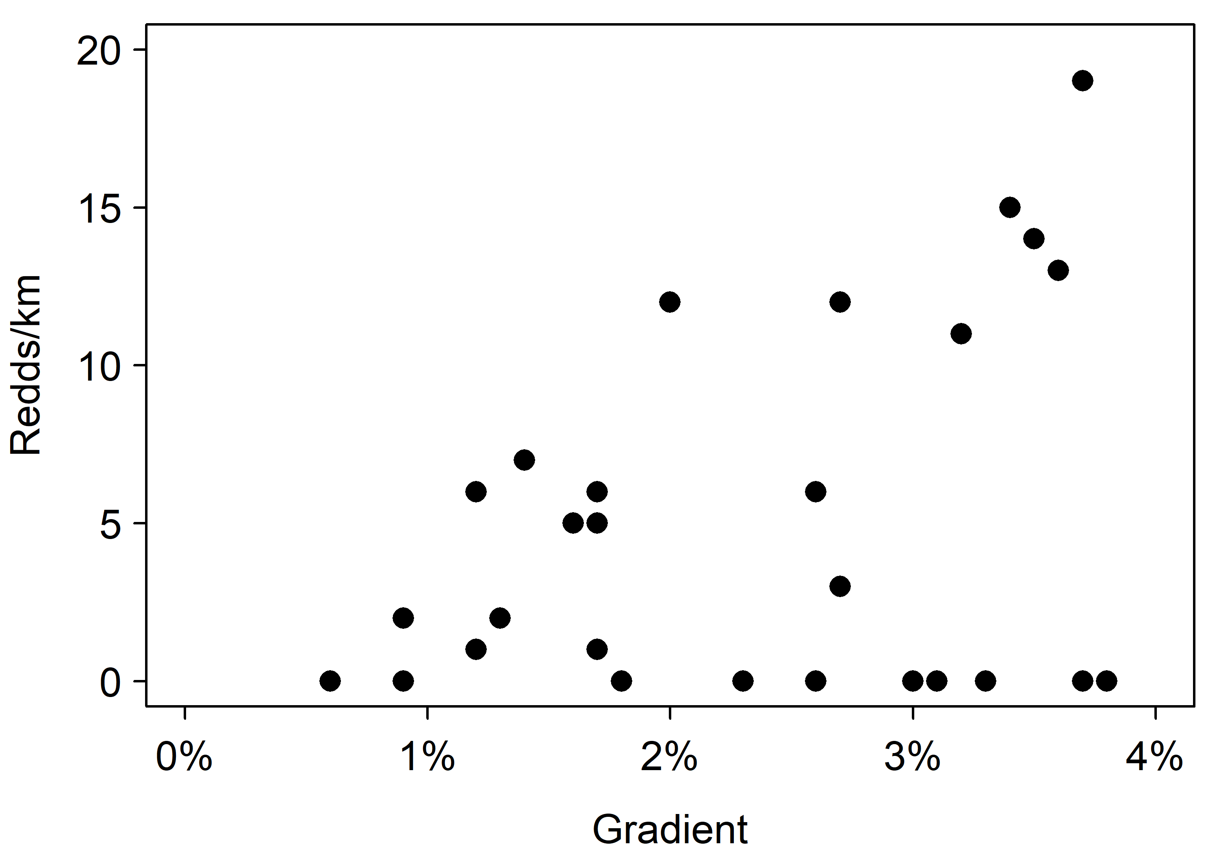
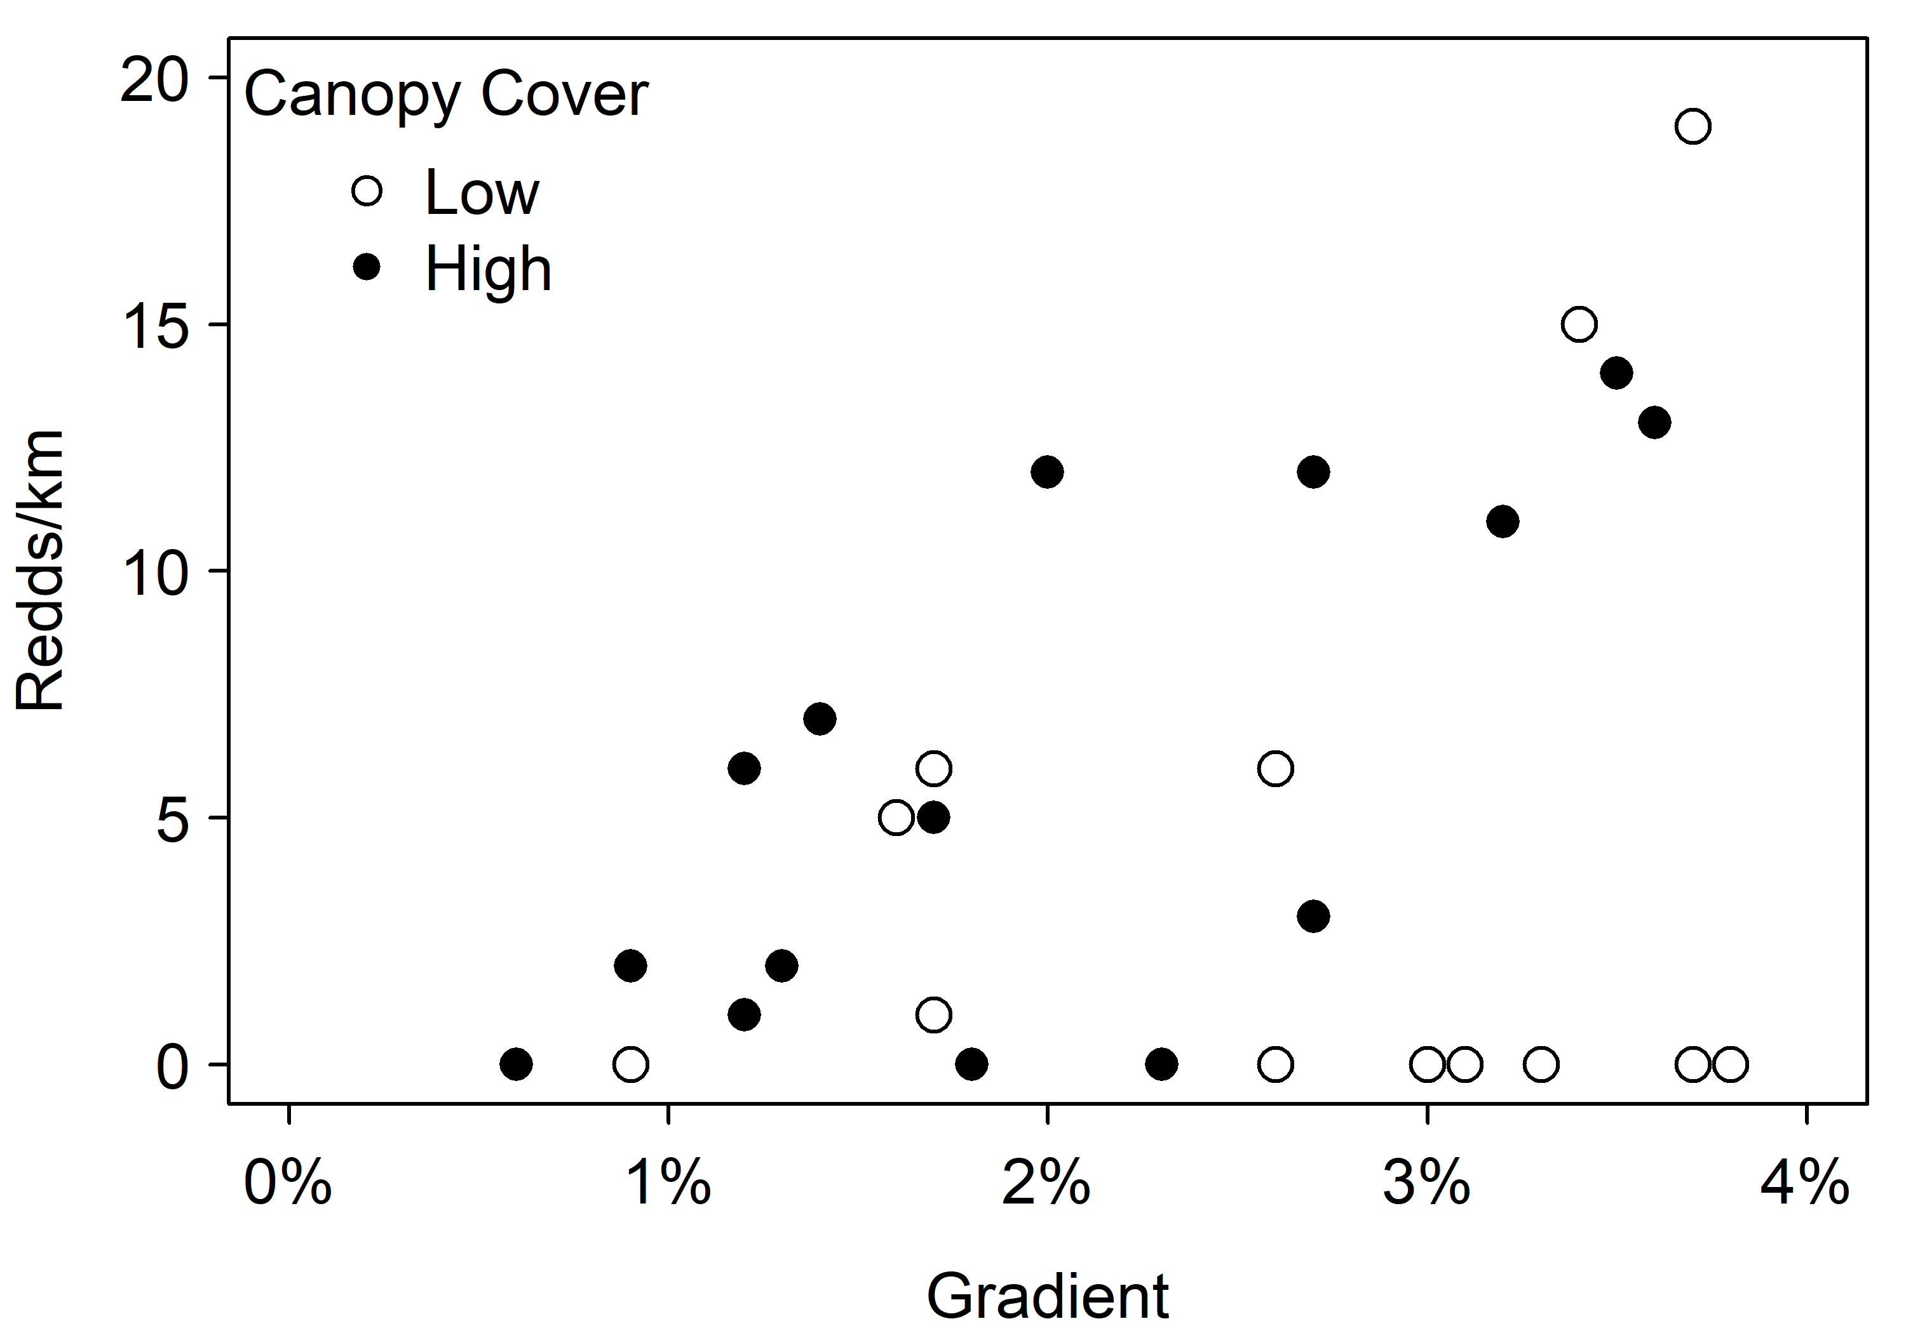
Who Has Messy Data?

Slide 37
ZIP: The Model
The “Zero” Model:
logit(ψ_{i}) = Z₀ + Z₁ * canopy_{i}
z_{i} ~ Bernoulli(1 - ψ_{i})
The “Count” Model:
log(λ_{i}) = B₀ + B₁ * gradient_{i}
Likelihood:
redds_{i} ~ Poisson(λ_{i}z_{i})

Slide 38
Go to R for Exercise 4
This exercise is contained in the Folder:
“…AFS19_2/Exercises/Exercise 2_4”
Open the file:
Exercise_2_4_Code.R
Set working directory to source file location
Like before, everything is coded except the model definition

Slide 39
Outline For Today
Morning: Intro and Fitting Models
Review of generalized linear models
Logistic regression
Poisson regression
Model checking with posterior predictive checks
Afternoon: More Complex Models
Zero-inflated Poisson regression
Review of mixed-effects/hierarchical models
Mixed-effect logistic regression
State-space Cormack-Jolly-Seber model with variations

Slide 40
What is a Mixed-Effect Model?
Includes both fixed and random effects
One way of saying it:
Explains variation we care about with fixed effects
Explains variation we don’t care about with random effects
Use hyperdistributions to do this

Slide 41
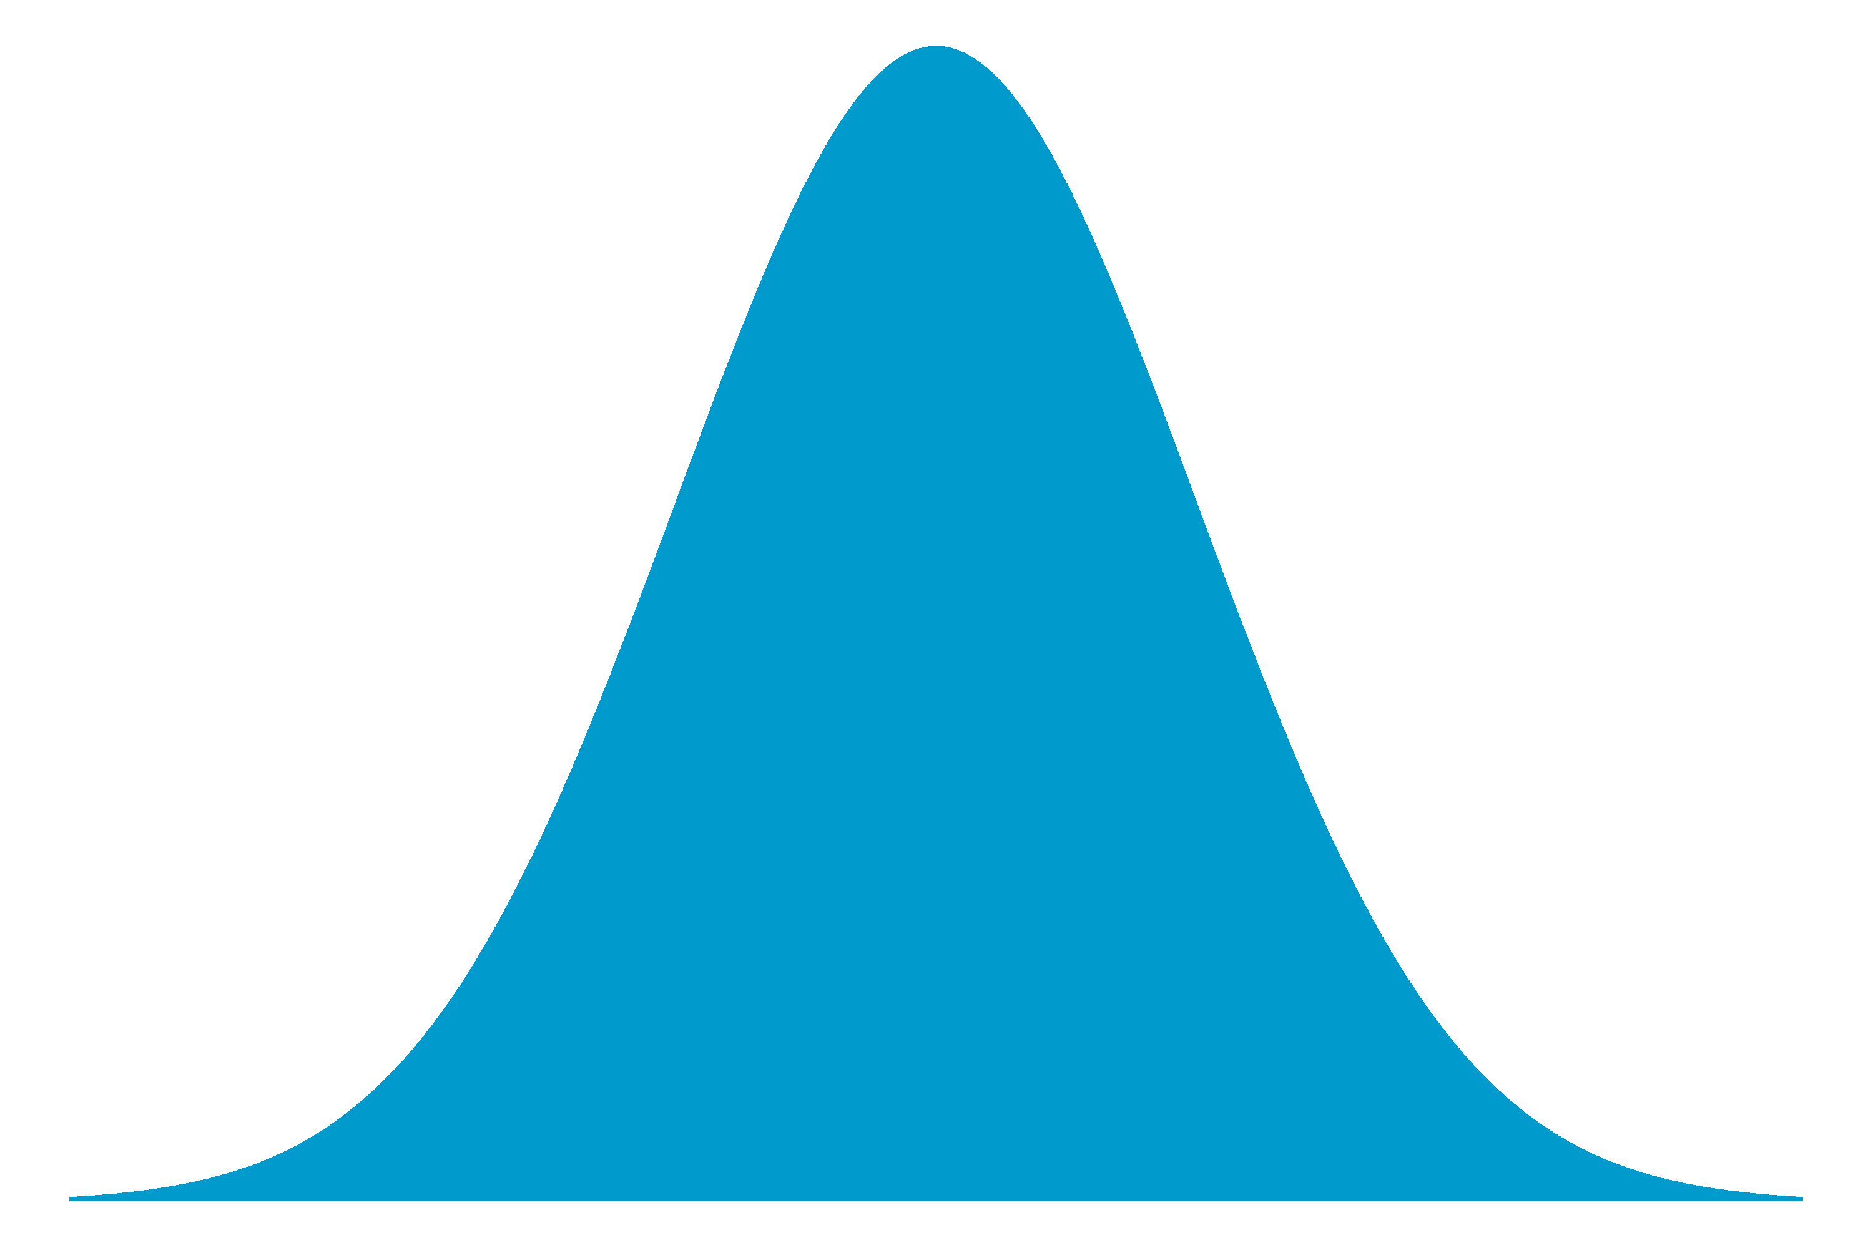
Hyperdistributions
Describe central tendency and variation of random parameters
μ₁
μ₂
μ₃
μ₄
Four means used separately
for groups 1,2,3,4
μ
These hyperparameters form
the basis for inference
But are all drawn from the same
hyperdistribution
σ

Slide 42
Example: Growth Study
T₁
T₂
T₂
T₁
T₂
T₁
T₂
T₁
T₁
T₂
T₁
T₂

Slide 43
Analysis Options
1.) Pool all T₁ data and all T₂ data, compare means
Between treatment variation may be washed out by between pond variation
2.) Treat pond-level differences as random effects
Accounts for between pond variation by treating all pond-level effects as drawn from hyperdistribution
Population-level expectation
Pond-level variability

Slide 44
Applications of Mixed Effects Models
Modeling random variation between individuals
Individual-specific growth curves using individual growth trajectories
Modeling random variation between sites
Location-specific probability of nest success
Modeling random variation over time
Annual survival fluctuates around a constant average

Slide 45
Applications of Mixed Effects Models
Modeling random variation between individuals
Individual-specific growth curves using individual growth trajectories
Modeling random variation between sites
Location-specific probability of nest success
Modeling random variation over time
Annual survival fluctuates around a constant average
If variation is systematic (e.g., temporal trends), explain with fixed-effects

Slide 46
Outline For Today
Morning: Intro and Fitting Models
Review of generalized linear models
Logistic regression
Poisson regression
Model checking with posterior predictive checks
Afternoon: More Complex Models
Zero-inflated Poisson regression
Review of mixed-effects/hierarchical models
Mixed-effect logistic regression
State-space Cormack-Jolly-Seber model with variations

Slide 47
Example: Mixed-Effect Logistic Regression
Use seven years of simulated data following Farmer et al. (2015)
We will apply the same analysis as before, this time treating different years as:
Fixed-effects first
Random effects

Slide 48
The Fixed-Effect Model
1.) The Linear Predictor
logit(p_{y,i}) = B_{0,y} + B_{1,y} * temp_{y,i}
2.) The Link Function
Turn from logit to probability scale
p_{y,i} = exp(logit(p_{y,i}))/(1 + exp(logit(p_{y,i})))
3.) The Response Distribution
Spawned_{y,i} ~ Bernoulli(p_{y,i})

Slide 49
The Mixed-Effect Model
1.) The Linear Predictor
B_{0,y} ~ Normal(μ_{B0}, σ_{B0});
B_{1,y} ~ Normal(μ_{B1}, σ_{B1})
logit(p_{y,i}) = B_{0,y} + B_{1,y} * temp_{y,i}
2.) The Link Function
Turn from logit to probability scale
p_{y,i} = exp(logit(p_{y,i}))/(1 + exp(logit(p_{y,i})))
3.) The Response Distribution
Spawned_{y,i} ~ Bernoulli(p_{y,i})

Slide 50
Go to R for Exercise 5
This exercise is contained in the Folder:
“…AFS19_2/Exercises/Exercise 2_5”
Open the file:
Exercise_2_5_Code.R
Set working directory to source file location
Like before, everything is coded except the model definition

Slide 51
Outline For Today
Morning: Intro and Fitting Models
Review of generalized linear models
Logistic regression
Poisson regression
Model checking with posterior predictive checks
Afternoon: More Complex Models
Zero-inflated Poisson regression
Review of mixed-effects/hierarchical models
Mixed-effect logistic regression
State-space Cormack-Jolly-Seber model with variations

Slide 52
Sources of Variation
All of the models we have covered so far have only dealt with one source of error or variation
Data do not match model predictions perfectly because of random variation in the system (process error)
We all know that data are not observed perfectly
There is also measurement error
E.g., in redd count model, some counts may be randomly higher or lower than the true number of redds
The model we fitted earlier assumed there was no measurement error in the y-variable

Slide 53
State-Space Models
A state-space model is one that separates the creation of a data set into two processes:
1.) True underlying biological state process
e.g., recruitment, survival, exploitation, etc.
2.) Observation process on true states
e.g., counting fish, sampling age, etc.

Slide 54
Example State-Space Model
Biological Process: Creates true states
N_{t+1}=N_{t} * r * (1 – N_{t}/k) + ε_{t,p}
State Equation
Process error – random deviations from state equation gives true states

Slide 55
Example State-Space Model
Biological Process: Creates true states
N_{t+1}=N_{t} * r * (1 – N_{t}/k) + ε_{t,p}
Observation Process: Creates observed states
Index_{t} = N_{t} * q
Obs.
State
True
State
Catchability – observe some constant proportion of population

Slide 56
Example State-Space Model
Biological Process: Creates true states
N_{t+1}=N_{t} * r * (1 – N_{t}/k) + ε_{t,p}
Observation Process: Creates observed states
Index_{t} = N_{t} * q
Model Fitting: Match observation to observed state
CPUE_{t} ~ N(Index_{t}, σ_{o})
Observed data have error around expected observation

Slide 57
State-Space Models are Tricky to Fit
Likelihood is messy
Observations are conditional on true, unobserved states
If true states are continuous, must integrate across all possible values
There are methods to do this with MLE, but often make restrictive assumptions
Bayesian methods already “do” the integration
MCMC samples from the joint posterior, which includes all of this mess
Intuitive framework to fit these kinds of models!

Slide 58
The Cormack-Jolly-Seber Model
Mark-recapture model that estimates survival
Multiple recapture periods
If you didn’t see an individual in a period, either it died or you didn’t detect it
False negative is measurement error
Observation of an individual is made up of two processes
Survival: to observe it, it must have survived to this point
Detection: you must have detected it

Slide 59
The State-Space Formulation
Separates the model into these two processes
The typical formulation also includes these two processes, but does not formally condition one on the other (King, 2012)
King, R. 2012. A review of Bayesian state-space modelling of capture-recapture-recovery data. Interface Focus, 2: 190-204.

Slide 60
The Data
Made up of individual recapture histories
0 denotes did not recapture alive (could be dead)
1 denotes a live recapture
 | j = 1 | j = 2 | j = 3 | j = 4 | j = 5 | j = 6 | j = 7 | j = 8
i = 1 | 1 | 0 | 1 | 0 | 0 | 1 | 0 | 1
i = 2 | 1 | 0 | 1 | 1 | 0 | 0 | 1 | 0
i = 3 | 1 | 1 | 1 | 0 | 0 | 0 | 0 | 0

Slide 61
Notation
i – individual
n – number of individuals
j – capture event
J – number of events
y – observed matrix of captures: n rows by J columns
z – matrix of true states: alive or dead (“estimated”)
p – detection probability (estimated)
φ – survival probability (estimated)

Slide 62
The Model
Biological Process: Bernoulli Survival Trial
z_{i,1} = 1 Alive at release
z_{i,j} ~ Bernoulli(z_{i,j-1} * φ)
Observation Process: Bernoulli Observation Trial
y_{i,j} ~ Bernoulli(z_{i,j} * p)

Slide 63
Model is Flexible
Simplest case: p and φ are constant across individuals (i) and events (j)
p or φ can vary by individual or event
We will build a couple models together, then turn you loose to build your own variation

Slide 64
Our Problem
We have a screw trap in the headwaters of a tributary
Inserted PIT tags in 500 outmigrating smolt
There are 5 receiver arrays in the tributary
River gets wider near confluence – detection effects?
There are several large bird colonies – survival effects?
Also measured fish length at release – survival effects?
Flow
Screw trap
(j = 1)
Mainstem

Slide 65
Our Problem
We have a screw trap in the headwaters of a tributary
Inserted PIT tags in 500 outmigrating smolt
There are 5 receiver arrays in the tributary
River gets wider near confluence – detection effects?
There are several large bird colonies – survival effects?
Also measured fish length at release – survival effects?
Flow
Array 2
(j = 3)
Array 1
(j = 2)
Array 3
(j = 4)
Screw trap
(j = 1)
Array 4
(j = 5)
Array 5
(j = 6)
Mainstem

Slide 66
Our Problem
We have a screw trap in the headwaters of a tributary
Inserted PIT tags in 500 outmigrating smolt
There are 5 receiver arrays in the tributary
River gets wider near confluence – detection effects?
There are several large bird colonies – survival effects?
Also measured fish length at release – survival effects?
Flow
Array 2
(j = 3)
Array 1
(j = 2)
Array 3
(j = 4)
Screw trap
(j = 1)
Array 4
(j = 5)
7m
Width = 5m
Array 5
(j = 6)
15m
20m
Mainstem
30m

Slide 67
Our Problem
We have a screw trap in the headwaters of a tributary
Inserted PIT tags in 500 outmigrating smolt
There are 5 receiver arrays in the tributary
River gets wider near confluence – detection effects?
There are several large bird colonies – survival effects?
Also measured fish length at release – survival effects?
Flow
Array 2
(j = 3)
Array 1
(j = 2)
Bird
colony
Array 3
(j = 4)
Screw trap
(j = 1)
Array 4
(j = 5)
7m
Width = 5m
Array 5
(j = 6)
15m
20m
Bird
colony
Mainstem
30m

Slide 68
Our Problem
We have a screw trap in the headwaters of a tributary
Inserted PIT tags in 500 outmigrating smolt
There are 5 receiver arrays in the tributary
River gets wider near confluence – detection effects?
There are several large bird colonies – survival effects?
Also measured fish length at release – survival effects?
Flow
Array 2
(j = 3)
Array 1
(j = 2)
Bird
colony
Array 3
(j = 4)
Screw trap
(j = 1)
Array 4
(j = 5)
7m
Width = 5m
Array 5
(j = 6)
15m
20m
Bird
colony
Mainstem
30m

Slide 69
Fit Three Models
Constant survival and detection probability
(Exercise 2.6.1)
Survival and detection vary as a function of site-level covariates
(Exercise 2.6.2)
Same as (2) but with individual-level covariate
(Exercise 2.6.3)

